Slide 1
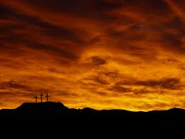


Now What?
Easter 2014
A CD of this message will be available (free of charge) immediately following today’s Bible study.
This message will be available via podcast later this week at calvaryokc.com

Slide 2
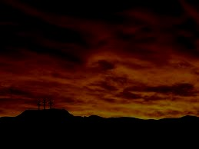
Now What?
Easter is on the first Sunday following the full moon after the vernal equinox on March 21.
Between March 22 and April 25

Slide 3
Now What?

Slide 4
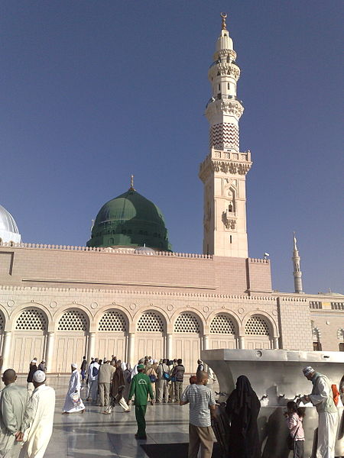
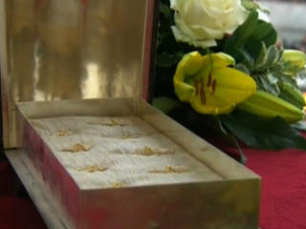
Now What?
Bones of St. Peter
Mausoleum of Mohammed

Slide 5
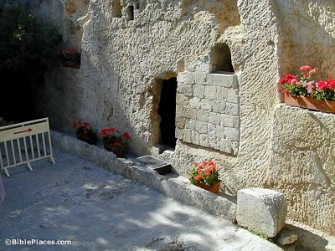
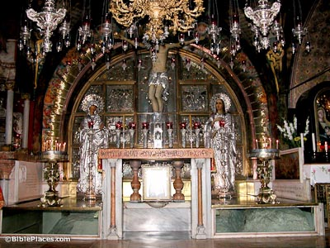
Now What?
?
The Garden Tomb
Church of the Holy Sepulchre

Slide 6
Now What?

Slide 7

Now What?
Now what?

Slide 8
Now What?

Slide 9
Now What?
Now what?

Slide 10
Now What?

Slide 11
Now What?
Luke 9.23 ~ If anyone desires to come after Me, let him deny himself, and take up his cross daily, and follow Me.

Slide 12
Now What?
1 Cor. 6.19-20 ~ ¹⁹ Or do you not know that your body is the temple of the Holy Spirit who is in you, whom you have from God, and you are not your own? ²⁰ For you were bought at a price; therefore glorify God in your body and in your spirit, which are God's.

Slide 13
Now What?

Slide 14
Now What?
The Westminster Shorter Catechism A.D. 1647
Question 1. What is the chief end of man?
Answer. Man’s chief end is to glorify God, and to enjoy him forever.
Augustine ~ "Thou hast formed us for Thyself, and our hearts are restless until they find rest in Thee."

Slide 15
Now What?

Slide 16
Now What?
Philippians 3.7-14

Slide 17
Now What?

Slide 18
Now What?
Rubbish ~ KJV, dung

Slide 19
Now What?

Slide 20
Now What?
Paraphrase ~ Not that I have already received it, or arrived at the finish line …

Slide 21
Now What?

